Slide 1
STATE OF MARYLAND LITERACY ASSOCIATION PRESENTS… 49TH ANNUAL CONFERENCE
APRIL 15-17, 2021

Slide 2
THURSDAY @ THE CONFERENCE…
Dr. Lisa Lucas

Slide 3
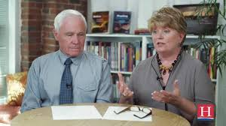
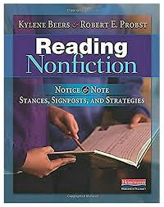
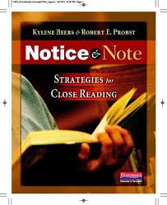
FRIDAY @ THE CONFERENCE…
Kylene Beers &
Robert E. Probst

Slide 4
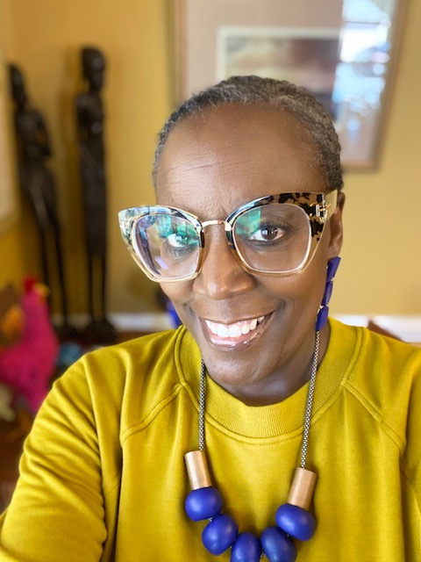
Glenis Redmond
F
R
I
D
A
Y

Slide 5
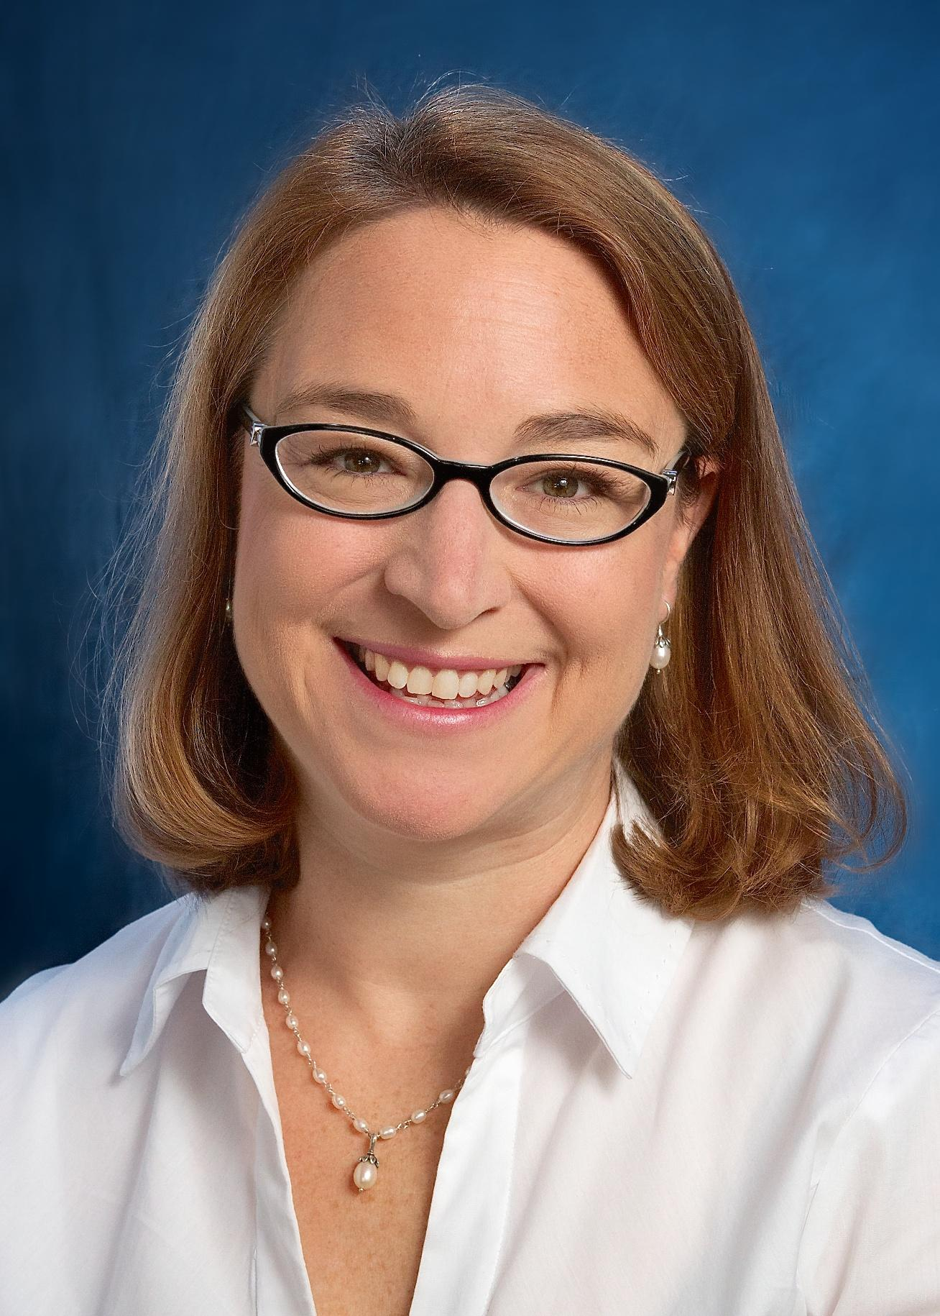
SATURDAY @ THE CONFERENCE…
Keynote & Featured Session
Dr. Nell Duke

Slide 6
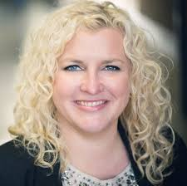
S
A
T
U
R
D
A
Y
Keynote & Featured session: Patty McGee

Slide 7
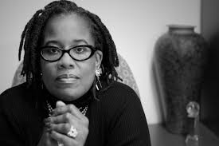
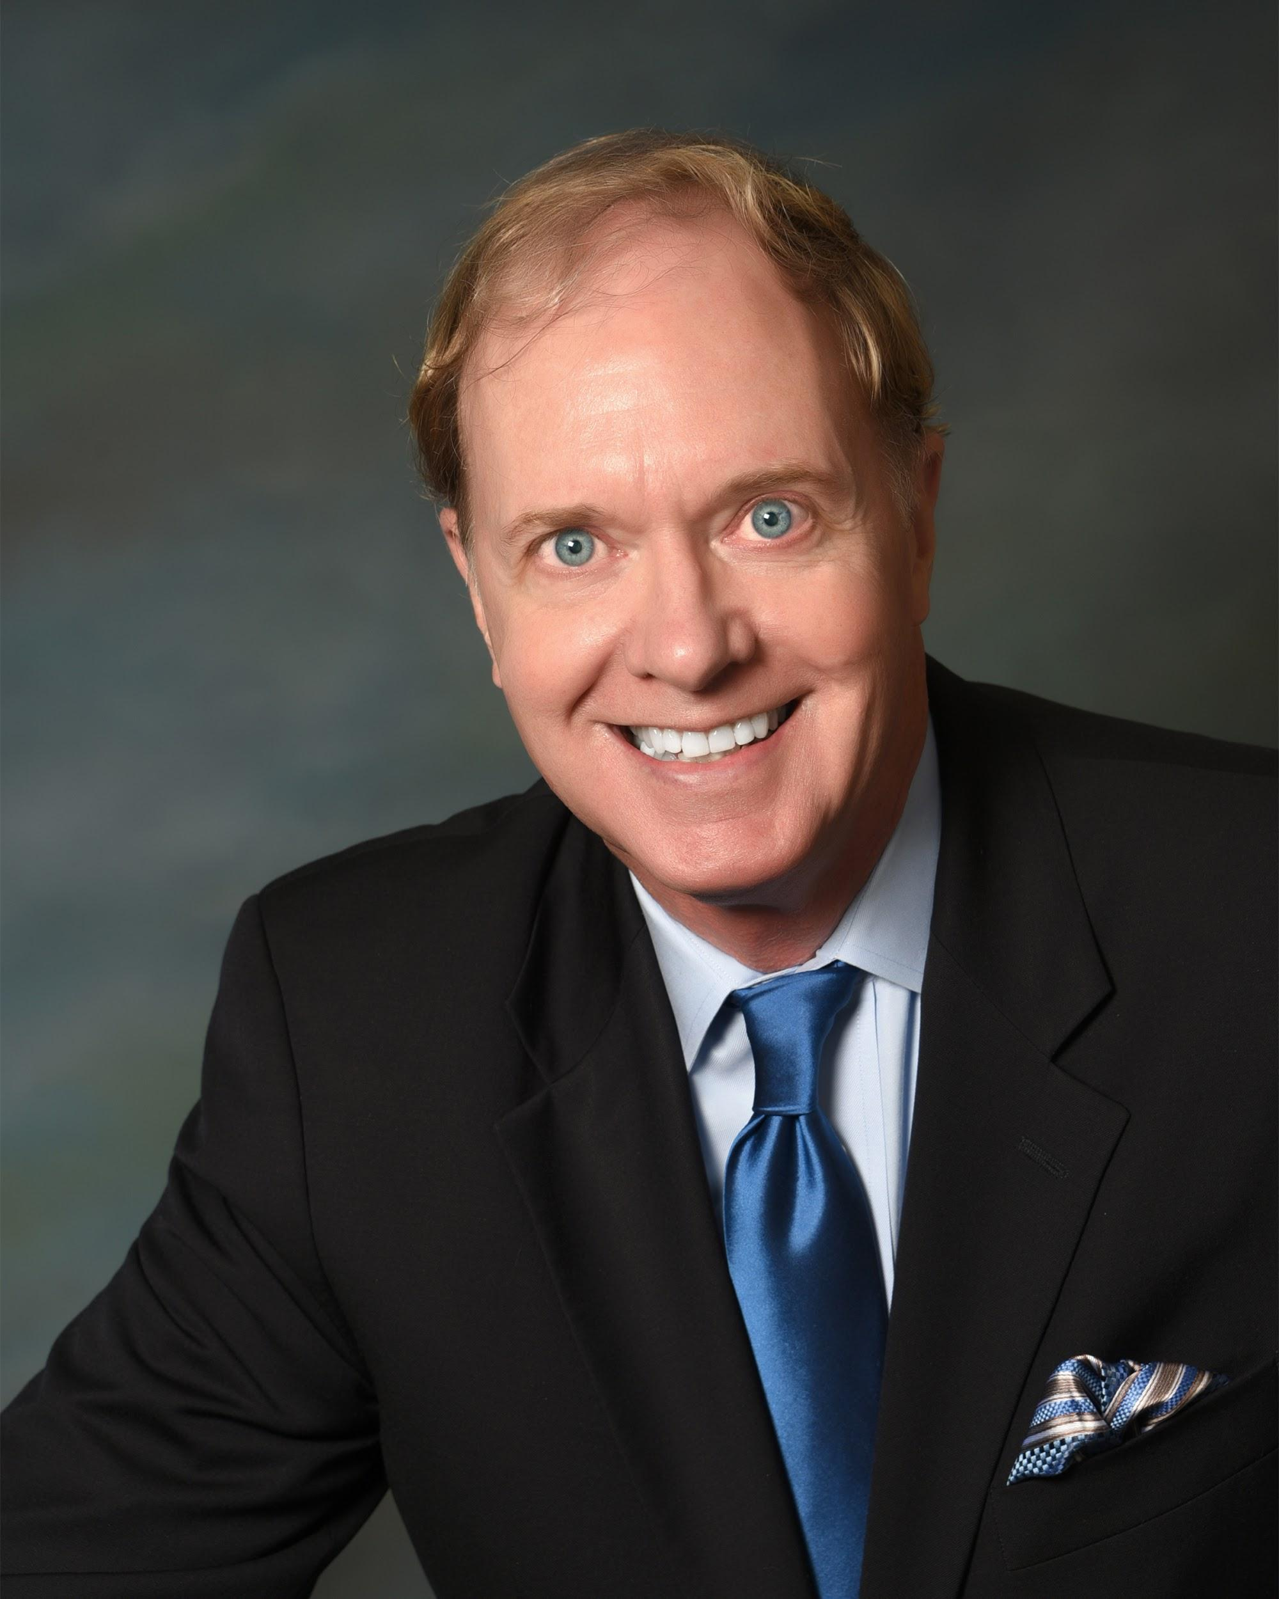
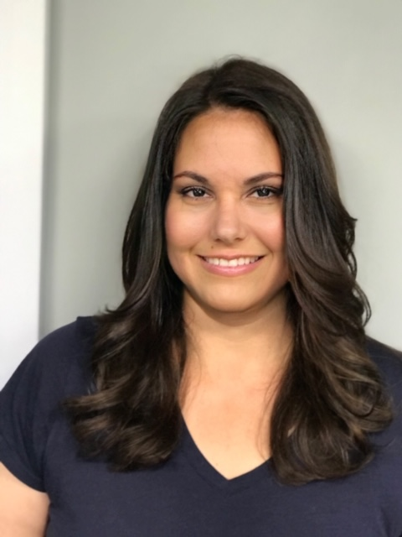
S
A
T
U
R
D
A
Y
Dr. Karsonya Whitehead
Dr. Richard Gentry
Amy Siracusano

Slide 8
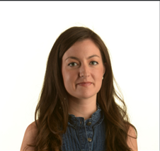
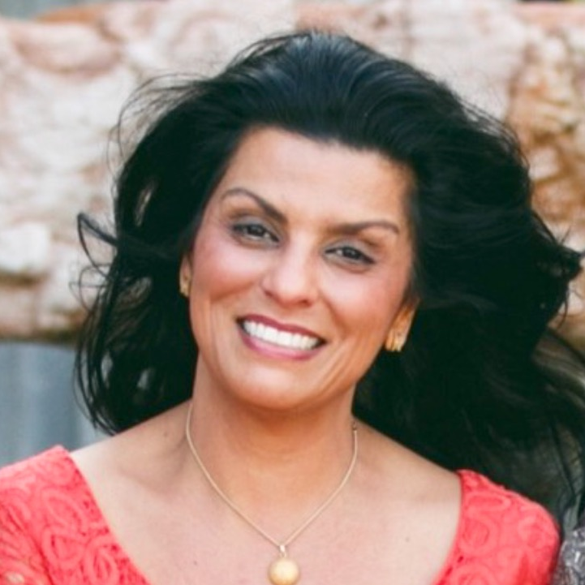
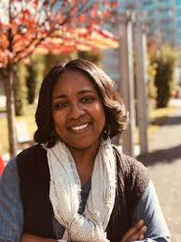
S
A
T
U
R
D
A
Y
Dr. Monica Burns
Katie Garner
Dr. Towanda Harris

Slide 9
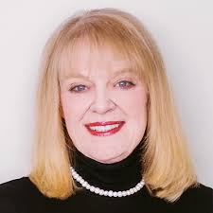
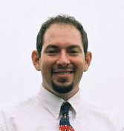
S
A
T
U
R
D
A
Y
Steve Tutunick
Kathy Bumgardner

Slide 10
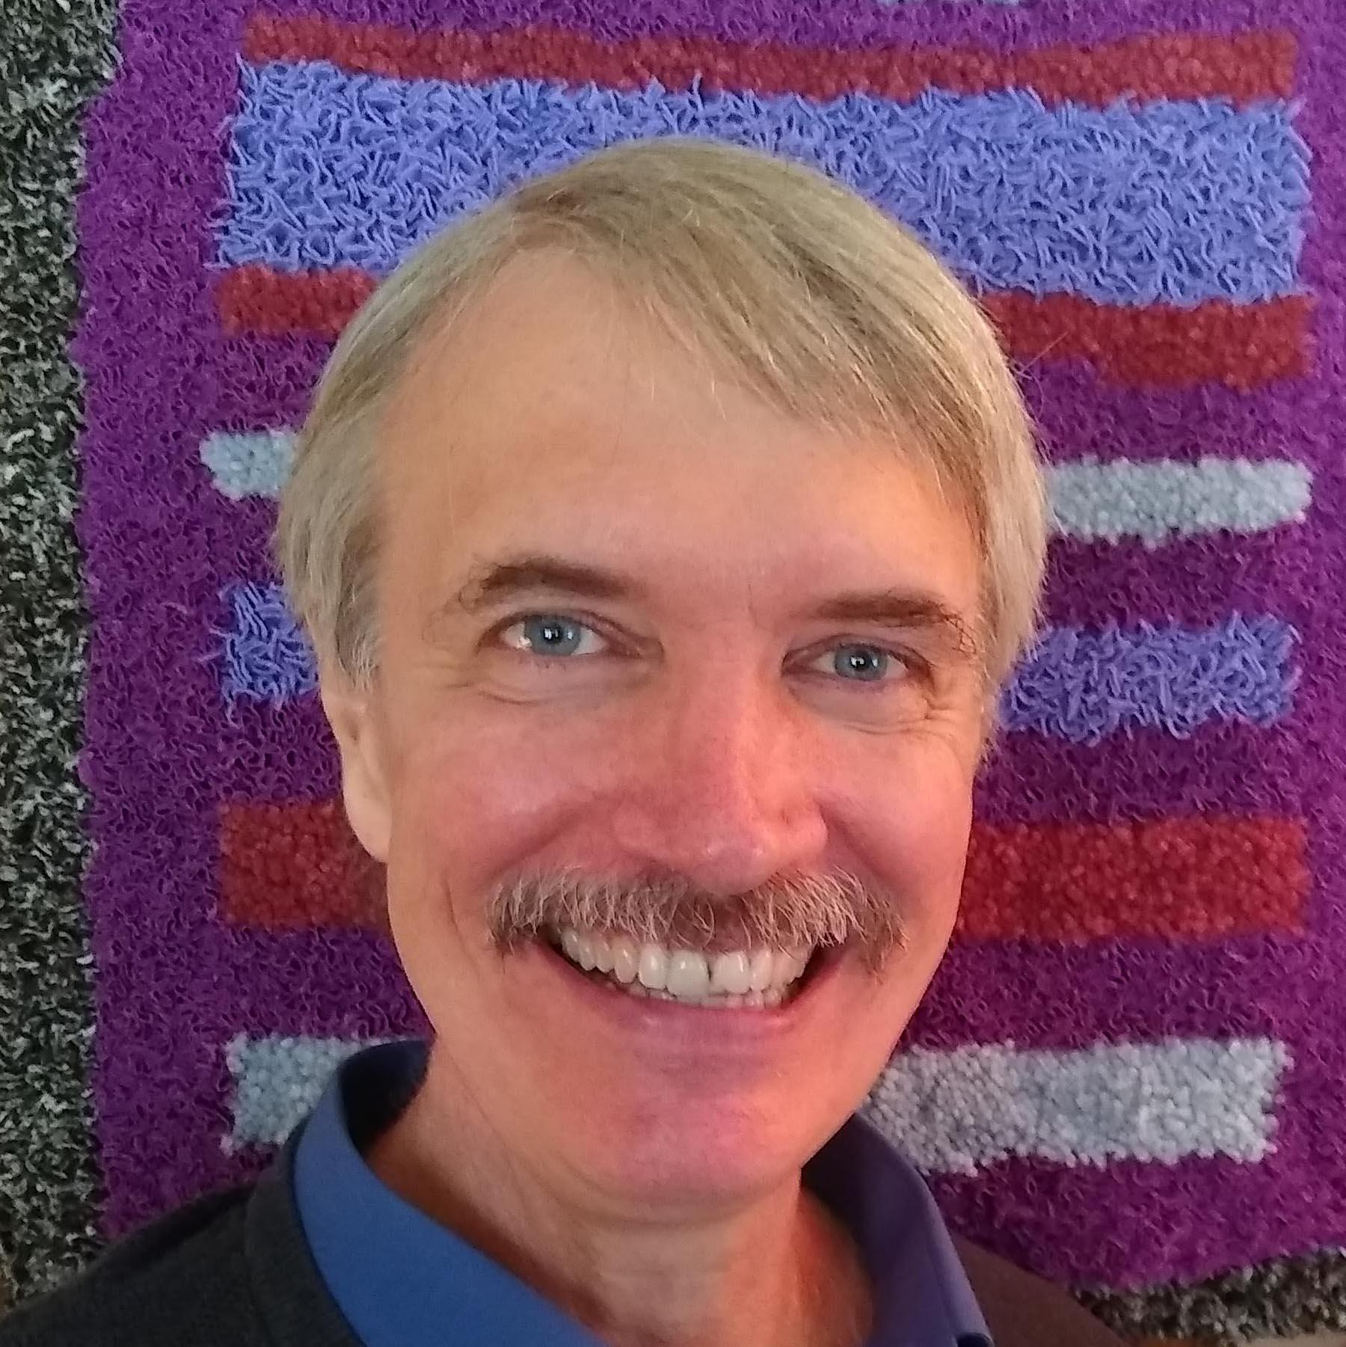
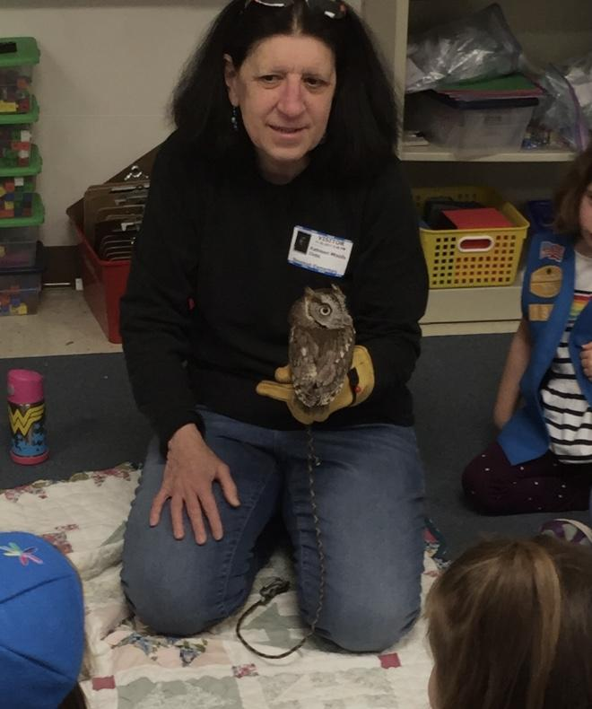
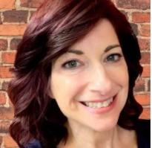
James Solheim
Jennifer Keats Curtis & Kathleen Woods
Randi Sonenshine

Slide 11
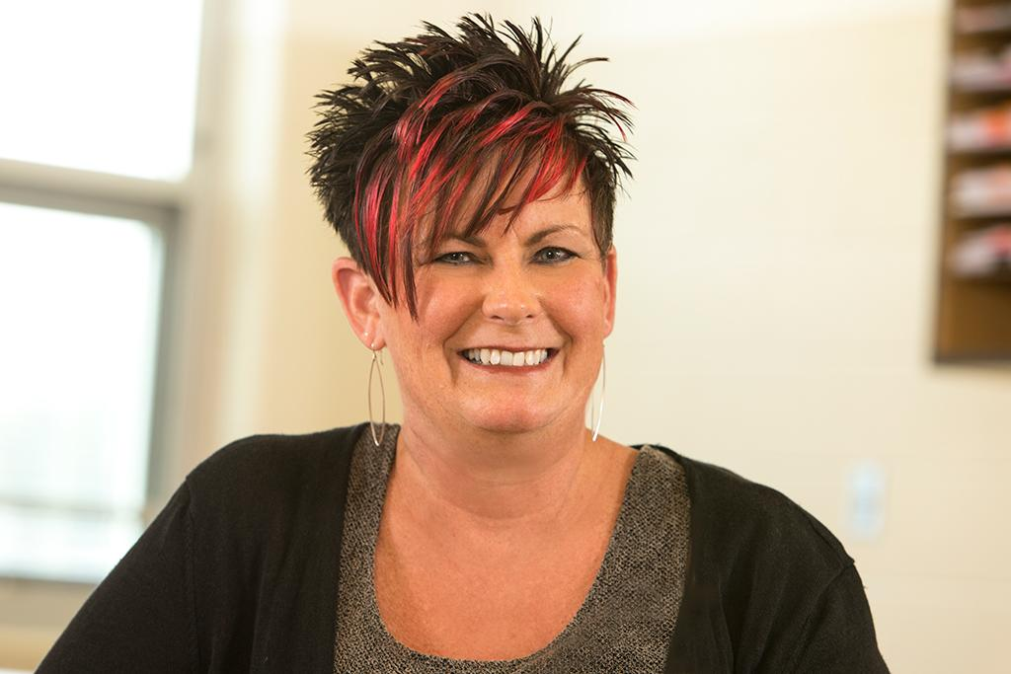
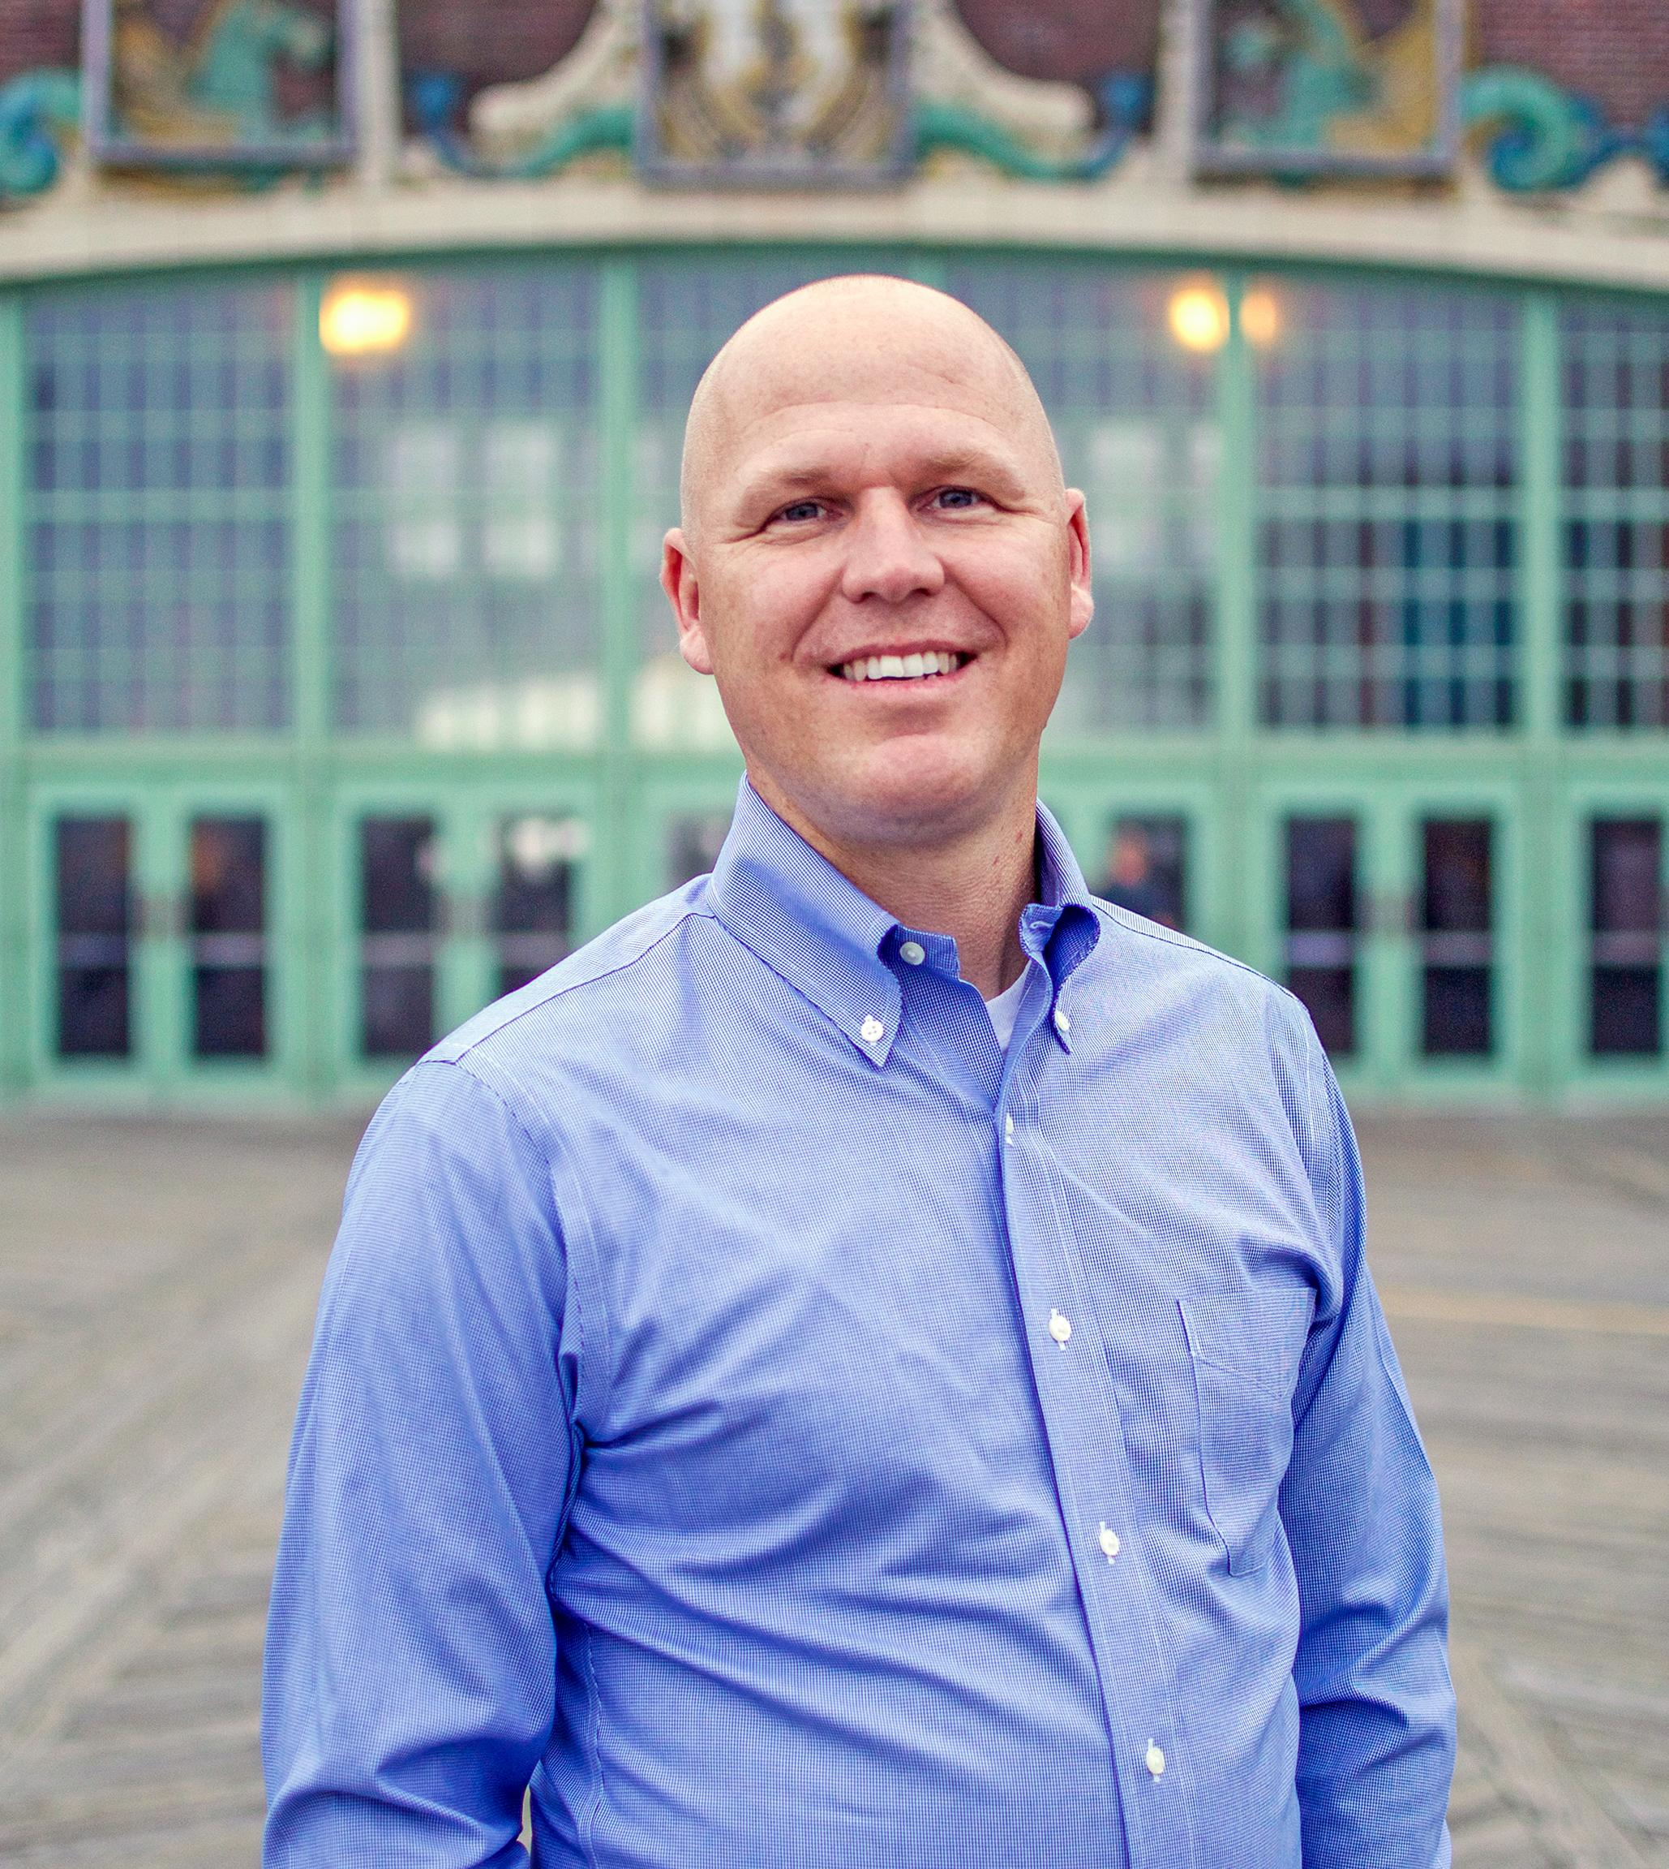
Tanny McGregor
Trevor Bryan

Slide 12
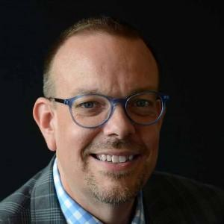
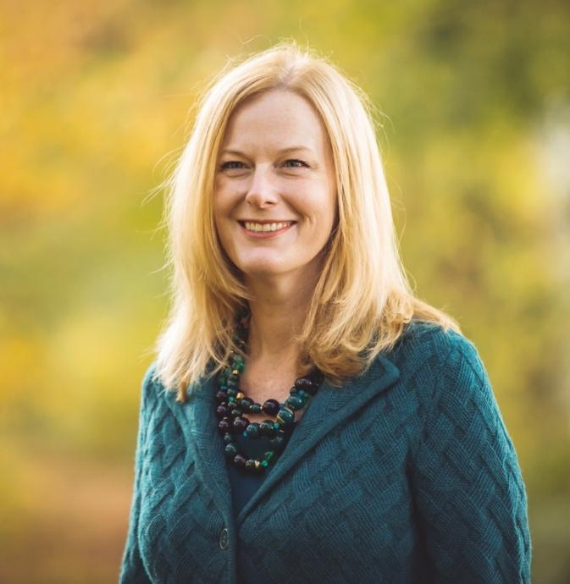
Dr. Miguel Reyes
Dr. Richard Hasenyager
Erin Lockledge

Slide 13
SoMLA 2021 Conference fees:
$25 SoMLA members, $20 college undergads, $40 nonmembers

Slide 14
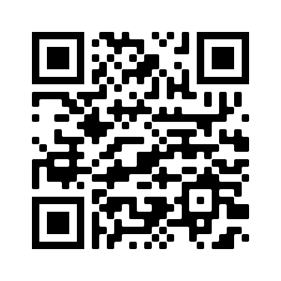
View our online schedule here:
SoMLA 2021 Virtual Conference: Log In (sched.com)

Slide 15
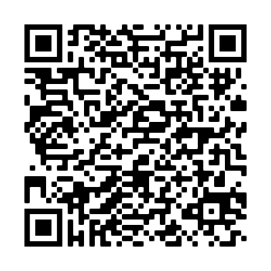
Register here :
SoMLA 2021 Virtual Conference "Literacy, The Key that Unlocks Doors" Tickets, Thu, Apr 15, 2021 at 6:30 PM | Eventbrite

Slide 16
SEE YOU ALL AT THE 49 ANNUAL CONFERENCE!
APRIL 15-17, 2021

