Slide 1
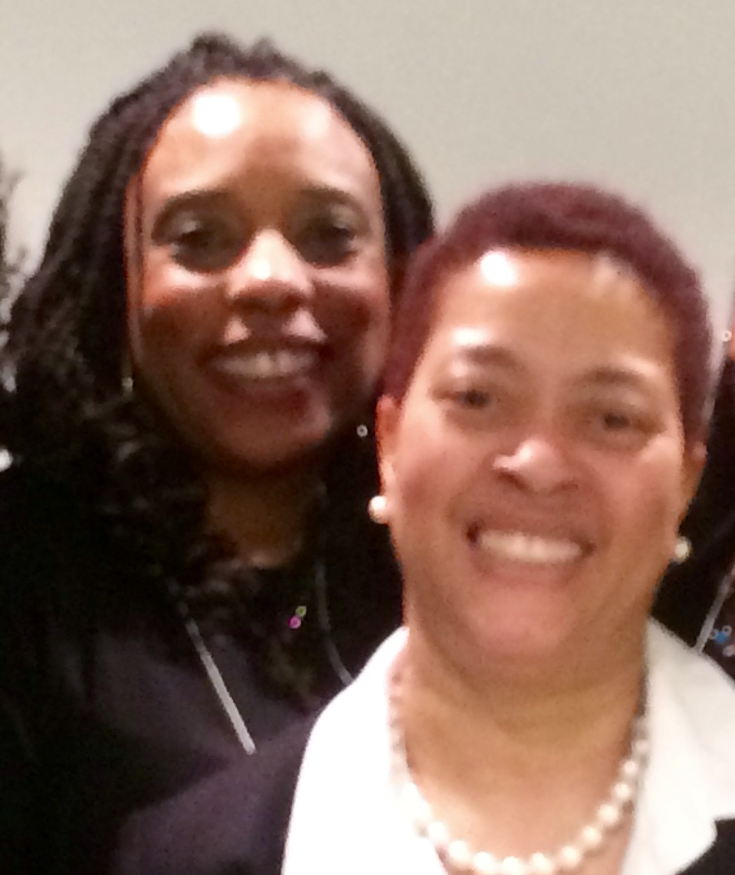
Prince George’s County Reading Council
RELEASE RELATE RELAX
at the
PGCRC POST PARCC PICNIC
Thursday May 12, 2016
5:00 pm - 7:00 pm
Bowie Comfort Inn
4500 Chain Highway
Bowie, MD 20716
Bring A Colleague and Enjoy.....
A Tasty Picnic Supper
Interactive & Informative PD Activities
"Social Studies Through the Lens of Literacy”
NBT Senetria Blocker (left) and
NBT Rainya Miller (right) share
Prizes
too!
Explore the Benchmark Education Digital Universe
Please RSVP carolyn.seubert@pgcps.org or
text 443-257-9950
by Tuesday May 10, 2016

