Slide 1
48th Annual SoMLA Conference
April 1 – 3, 2020

Slide 2
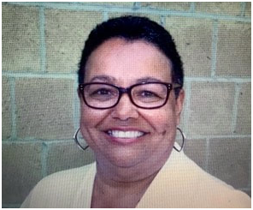
A tribute to Judi Hunter

Slide 3
Judi’s Picks…..

Slide 4
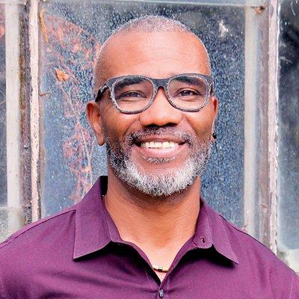
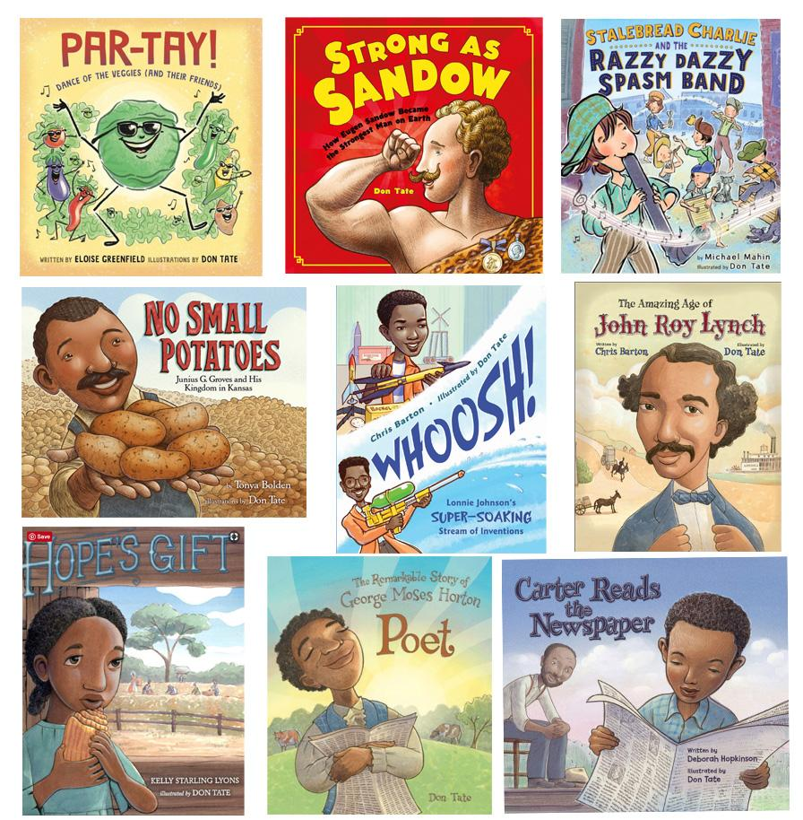
Don Tate
Author & Illustrator
Notes:
Primary/intermediate

Slide 5
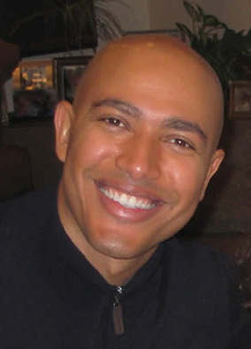
Torrey Maldonado
Notes:
Middle/HighTorrey Maldonado, the author of the critically acclaimed Secret Saturdays, is a teacher in Brooklyn, New York, where he was born, raised, and lives. His books reflect his students' and his experiences.

Slide 6
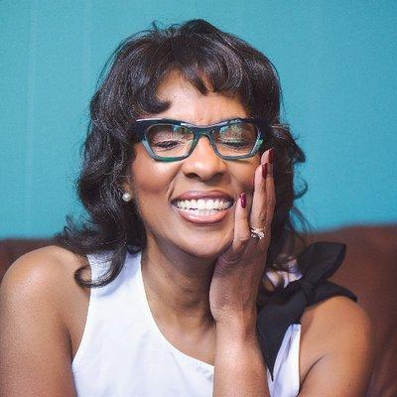
Alice Faye Duncan
Notes:
Primary- MEMPHIS, MARTIN AND THE MOUNTAINTOP
A 2019 Coretta Scott King Honor Medal
Also voted a "Best Picture Book in 2018' by Kirkus, SLJ and Booklist

Slide 7
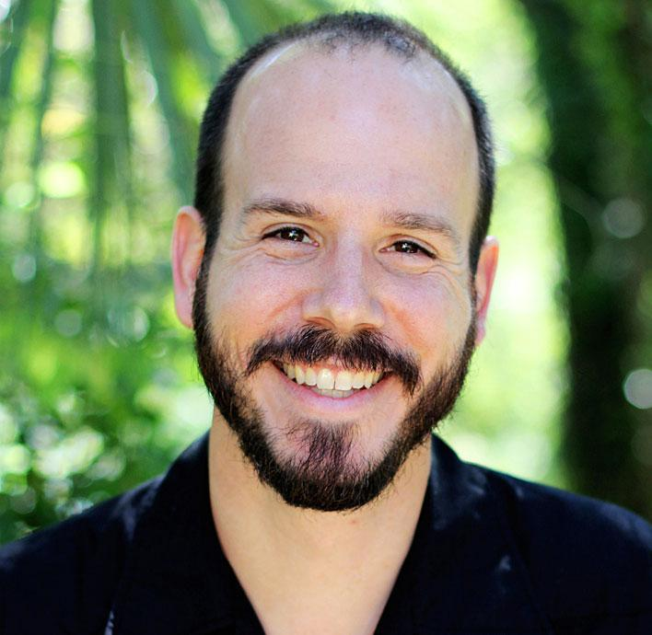
Chris Barton
Notes:
-primary; Austin TX based author

Slide 8
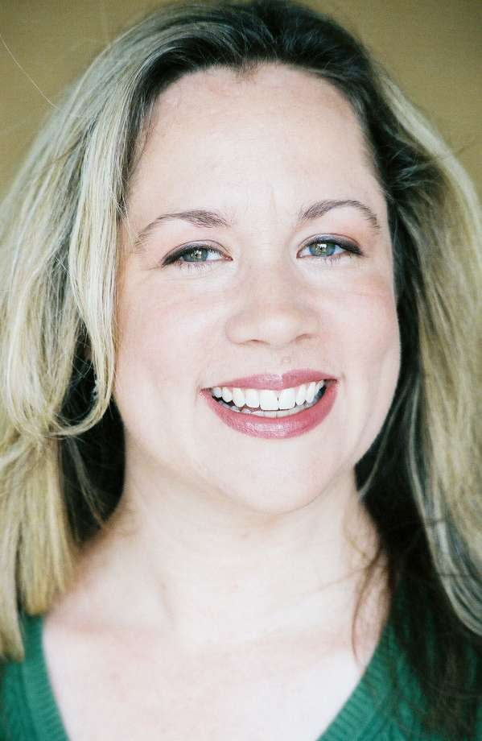
Jennifer Ziegler
Notes:
Jennifer Ziegler-Grades 4-8

Slide 9
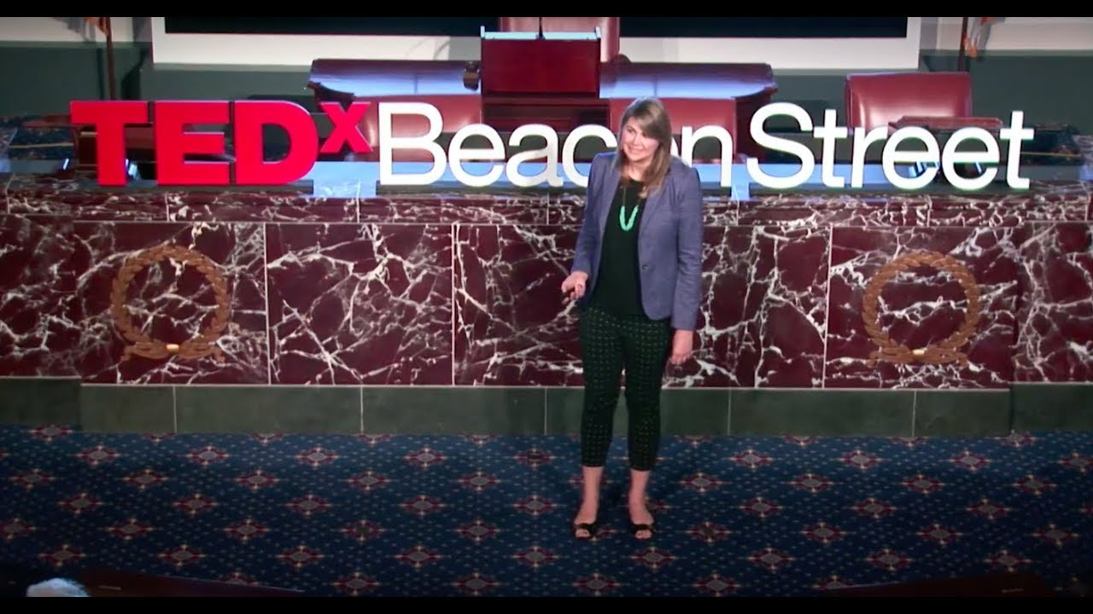
Sydney Chaffee
2017 National Teacher of the Year
www.sydneychaffee.com

Slide 10
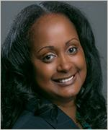
Juli-Anne Benjamin

Slide 11
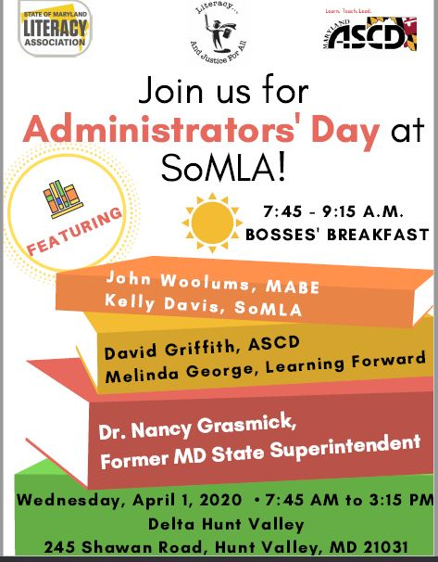
Wednesday Administrators’ Day
April 1, 2020

Slide 12
Lynmara Colon’
Redesigning Schools: Environments Inspired by Literacy

Slide 13
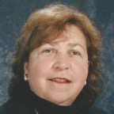
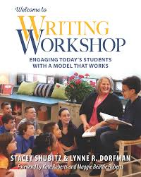
Lynne Dorfman
Writing Workshop

Slide 14
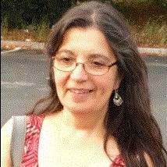
Maria Campanario
Learning Specialist for Special Populations
Notes:
aria Campanario
McGraw-Hill Education
Learning Specialist for Special Populations
McGraw’s Learning Specialist for Special Populations, Maria Campanario, has over 39 years of experience in public education in a variety of teaching and administrative roles. Her work has concentrated on building effective schools, particularly on matters pertaining to project based learning, literacy, academic language development, English Language Learners, special education and supporting district/school administrators in organizational planning. She provides leadership for administrator professional development on current key national educational issues such as ESSA, WIDA, state standards, and the Dear Colleague letter. Nationally she has also presented professional development sessions focused on acculturation, secondary literacy, culture, race, urban education and socio-emotional learning for diverse special populations.

Slide 15
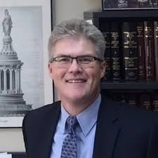
John Woolums
MABE Director of Government Relations

Slide 16
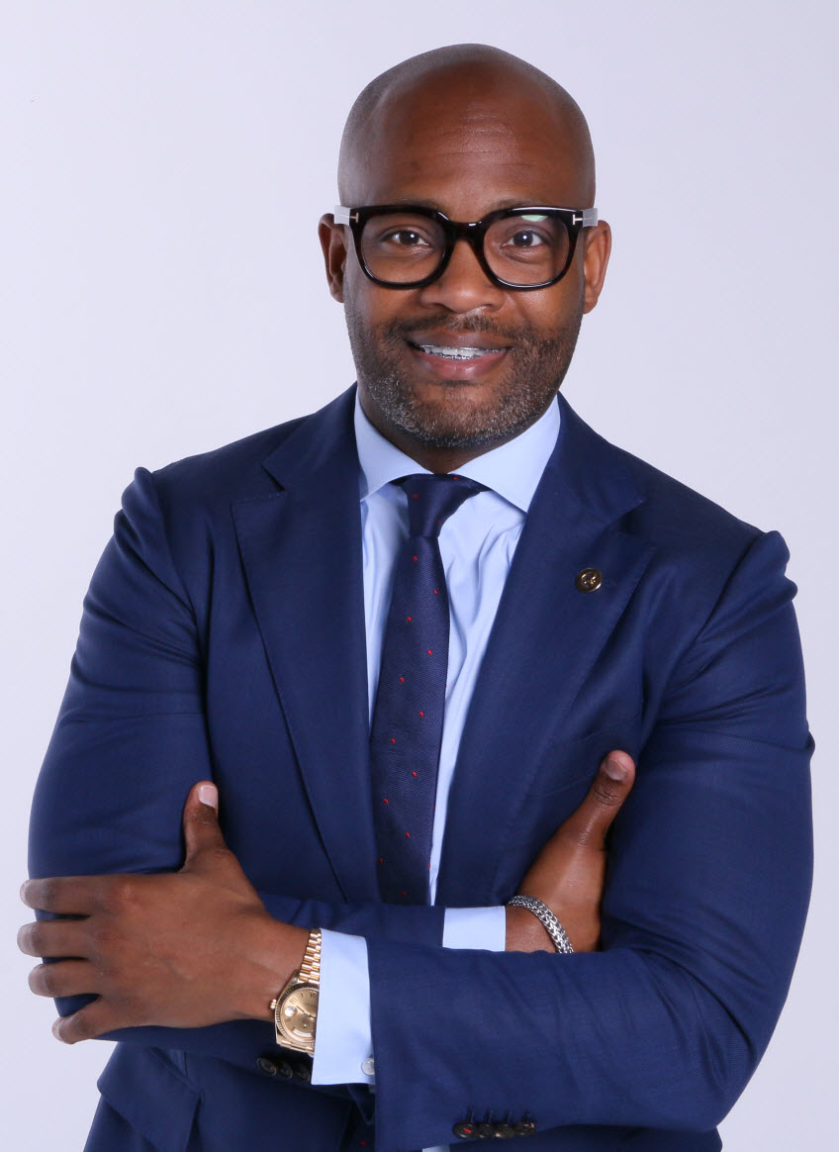
Dr. Donyall Dickey
National authority on curriculum, instruction, organizational development, and administration of schools.
Unparalleled levels of student achievement and school improvement with ground-breaking research on resilience and African American males.
Dr. Dickey began his career as a third grade teacher in the Baltimore City Schools before becoming a high school English literature/SAT prep teacher, assistant principal to principal to CAO in several cities. Published 33 books instructional text based.
Sponsored Scholastic Professional

Slide 17
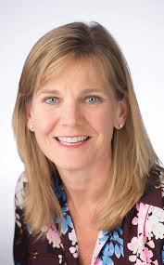
Melinda George
Melinda leads Learning Forward’s national and state policy agenda as well as strategic partnerships to ensure collaboration and build support for great teaching and learning.

Slide 18
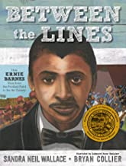
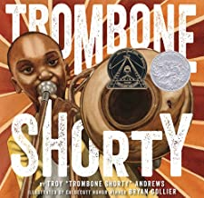
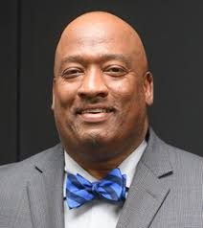
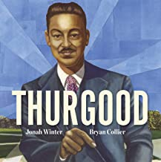
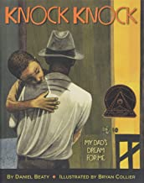
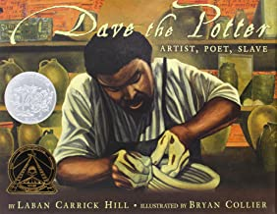
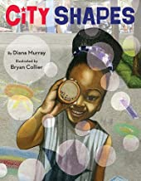
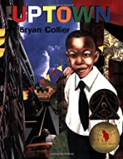
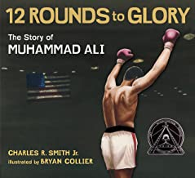
Bryan Collier

Slide 19
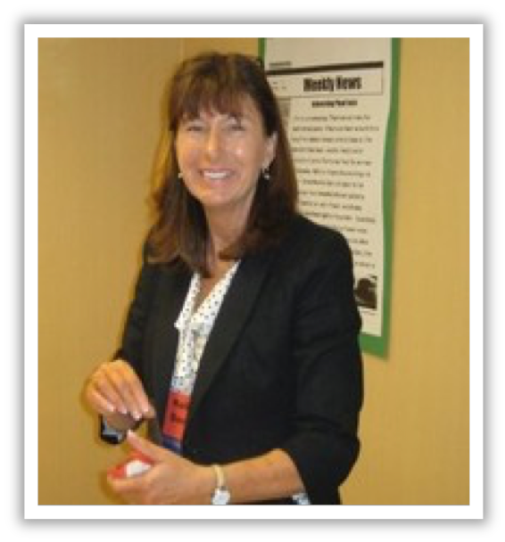
Kelly Davis
Social & Emotional Education in Literacy

Slide 20
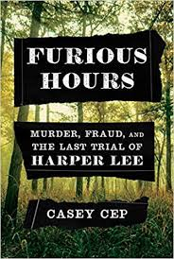
Casey Cep
Casey Cep is a staff writer at The New Yorker. Her first book, “Furious Hours: Murder, Fraud, and the Last Trial of Harper Lee,” was published in May. She is a graduate of Harvard College and the University of Oxford, where she studied as a Rhodes Scholar. She lives on the Eastern Shore of Maryland.
(High School Author)

Slide 21
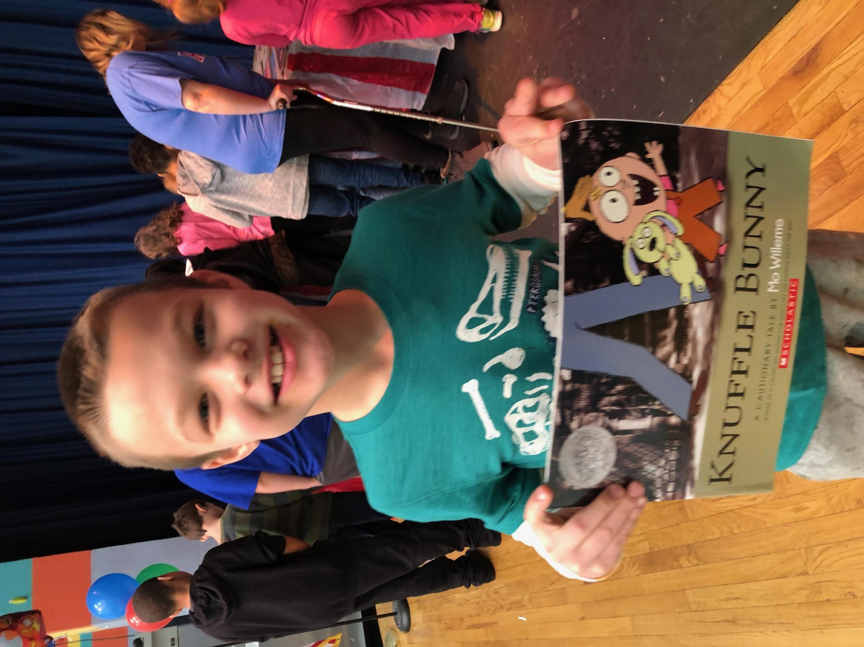
Lisa Lowe & Katie Ryan
Creating a Culture of Literacy
Feeling a lack of passion for literacy at your school? Want to up your game? Hope to bring 'life' back into reading? Find your joy by creating a school-wide culture of literacy and a passion for reading!
Students need to know that WE believe reading is important. Readers who are inspired and encouraged will become stronger readers and leaders. Enthusiasm for reading and learning is contagious. Walk away recharged with hands-on, research based, real life tools that you can use immediately in your own school to encourage and promote a culture of literacy.

Slide 22
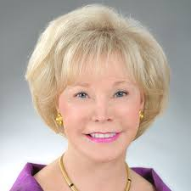
Nancy Grasmick
Maryland’s first female state superintendent of schools, is known for her strong focus on student achievement, teacher quality, and public school funding. She currently serves as a member of the National Math and Science Initiative.

Slide 23
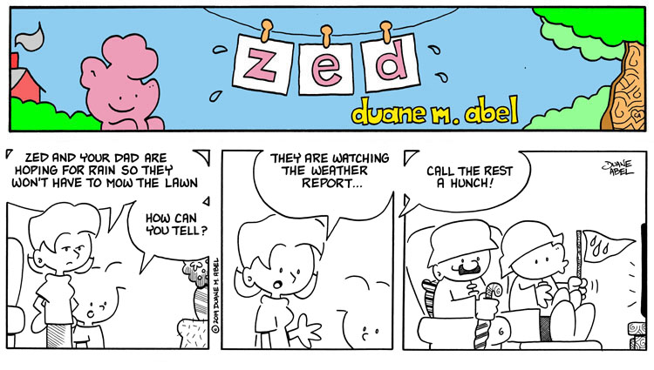
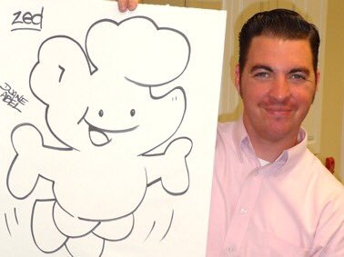
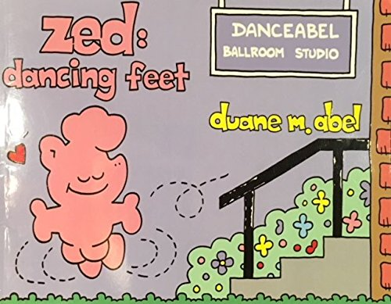
Duane Abel
Duane Abel
DRAW YOUR DESTINY with Duane M. Abel builds such momentum with his four words required for success it leaves educators inspired!
Graphic Author
Illustrator
Motivational Speaker

Slide 24
David Griffith
Griffith
Senior Director of Advocacy and Government Relations, leading ASCD's efforts to influence education decision-making at the federal, state, and local levels and the development and implementation of the association's legislative agenda. He has played an instrumental role in promoting multimetric accountability and a whole child approach to education, as well as being a national speaker and resource expert on the Every Student Succeeds Act (ESSA).

Slide 25
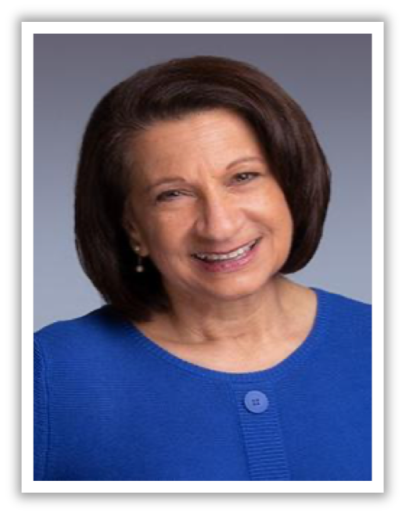
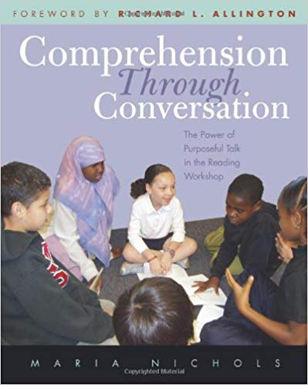
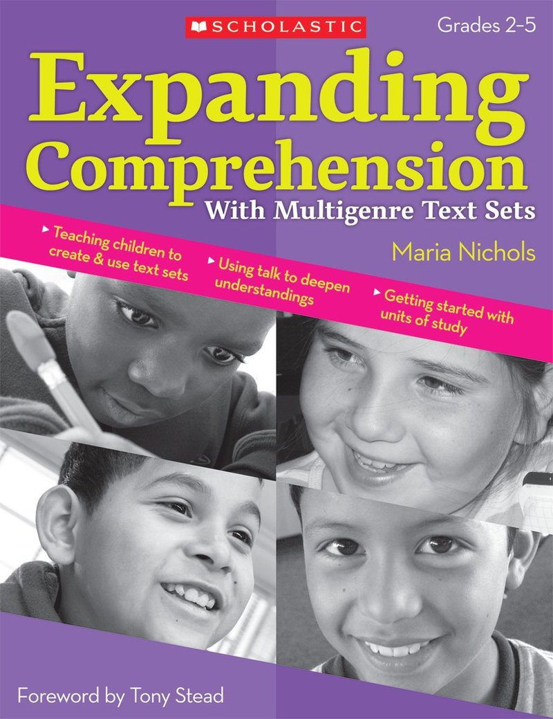
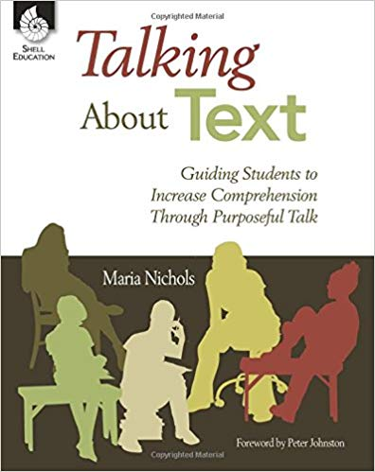
Maria Nichols

Slide 26
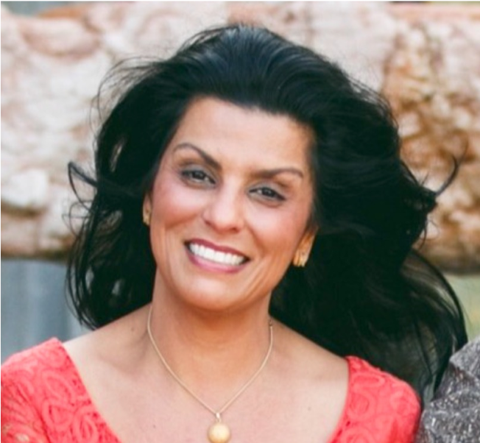
Katie Garner
Infusing brain science into phonics instruction and providing educators with innovative yet practical ideas for aligning existing literacy curriculum and instruction with cutting-edge research, showing just how our brains learn best!

Slide 27
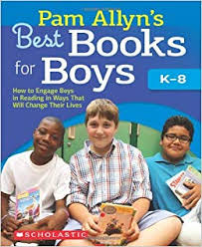
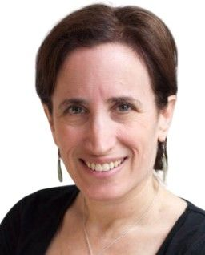
Pam Allyn

Slide 28
Wine & Cheese Reception
Join us for a complimentary Wine & Cheese Reception in Garden immediately after the Monday keynote.

Slide 29
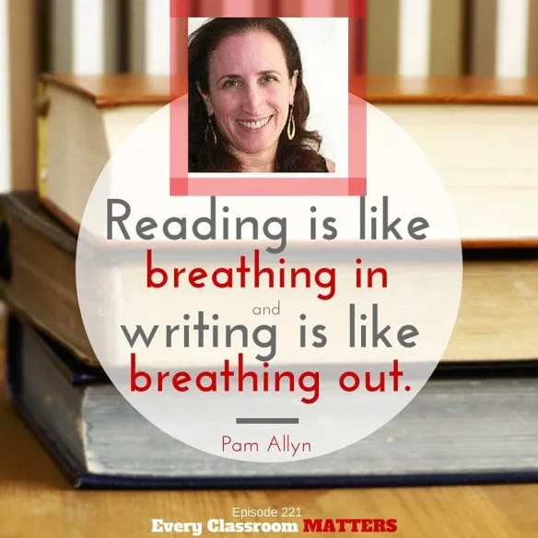
Dinner with Pam Allyn
Join us for an intimate dinner with Pam Allyn and have an in-depth conversation as her passion for literacy and justice for all moves forward in her fight for all children

Slide 30
April 2, 2020

Slide 31
Books & Breakfast
Don Tate:
The Journey

Slide 32
Keynote Speaker
Juli-Anne Benjamin
Equity Frameworks
Leader, rooted in culturally responsive and sustaining pedagogical practices in literacy instruction and leadership.
Harvard University Graduate School of Professional Education

Slide 33
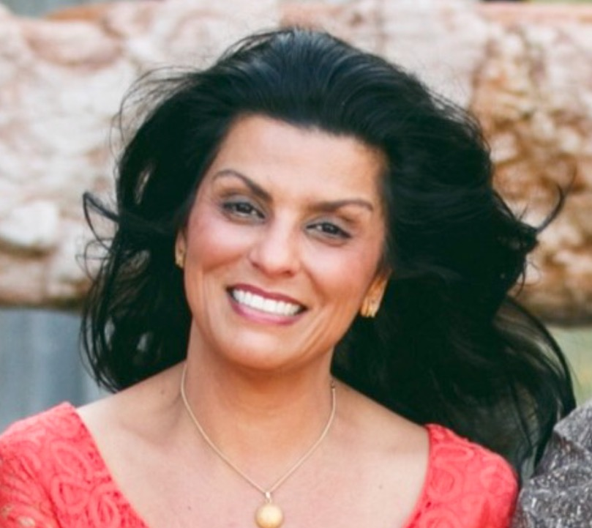
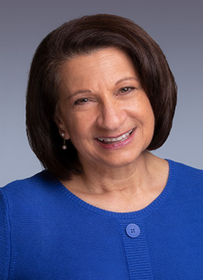
Katie Garner
Infusing brain science into phonics instruction and providing educators with innovative yet practical ideas for aligning existing literacy curriculum and instruction with cutting-edge research, showing just how our brains learn best!

Slide 34
Patrice Brown
Looking at literacy through the front door and the school door….

Slide 35
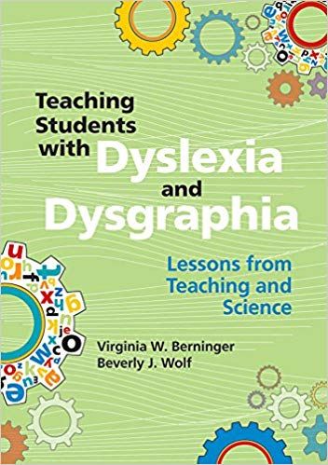
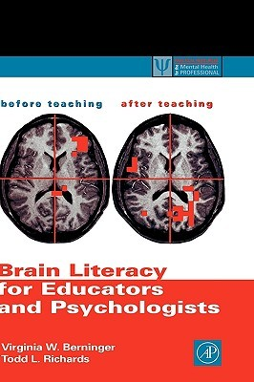
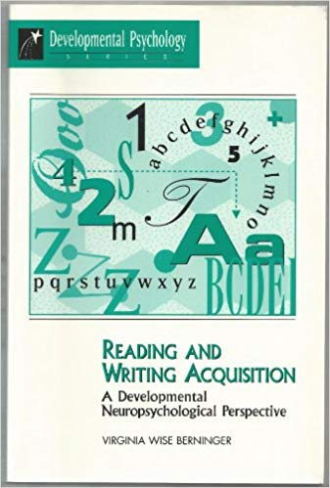
Virginia Berninger
The Contrasting Writing Disabilities of Dysgraphia, Dyslexia, and Oral and Written Language Learning Disability
The Contribution of Writing to Reading
The Other Three Tier Model for Reading and Writing: Screen-Intervene for Prevention, Problem Solving Consultation, and Treatment-Relevant Differential Diagnosis of SLDs

Slide 36
Bryan Collier

Slide 37
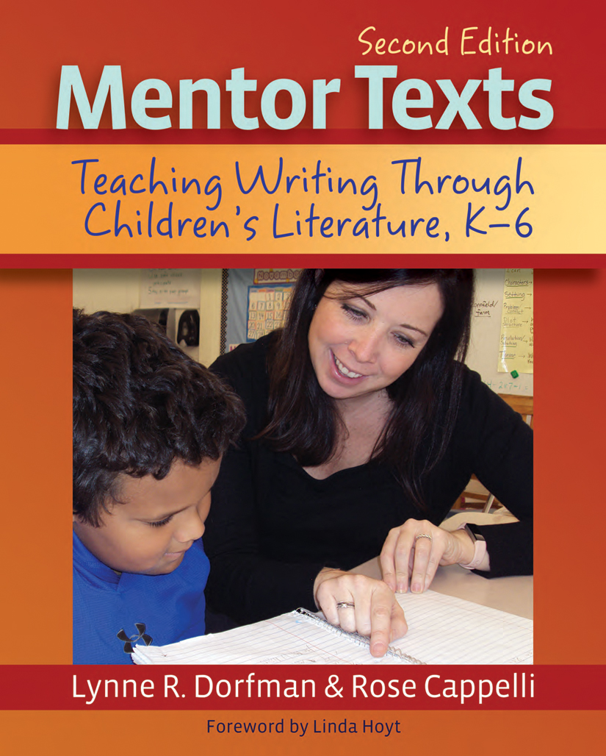
Lynne Dorfman
Writing Workshop

Slide 38
Keynote Speaker
Kenneth Kunz

Slide 39
Literacy Lottery Scholarship Fund Drive
Tickets are available throughout the day. 3 for $1 or 20 for $5. Prizes will be drawn immediately following Thursday afternoon keynote in Hunt & Valley, have your tickets ready! Participants must be present to win. SoMLA greatly appreciates the generous donations of gifts by our exhibitors, local chapters, and individuals. Thank you for supporting the Joseph J. Fox Memorial Scholarship Fund.

Slide 40
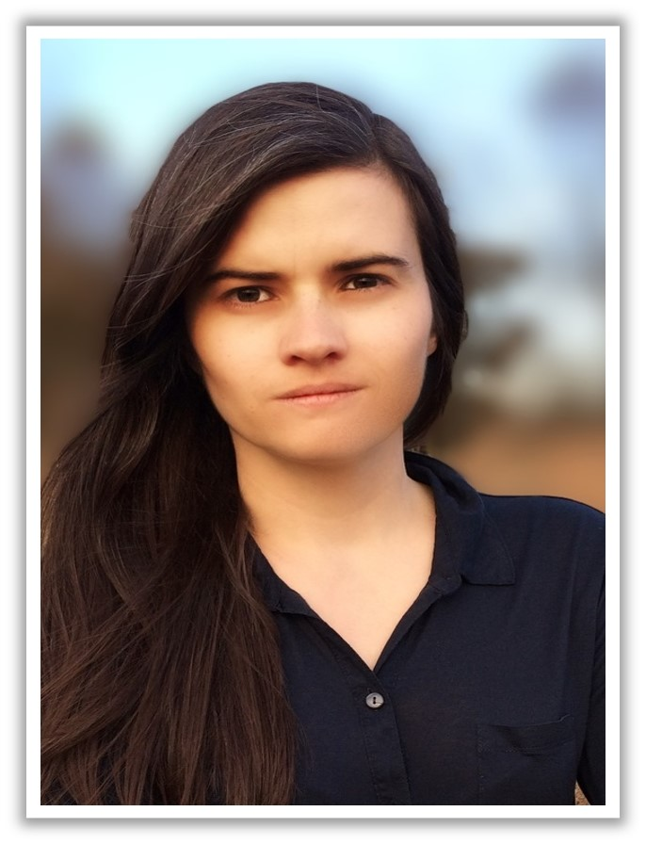
An Evening With the Authors
When you sign-up for this event you hear from all the authors, receive 1:1 time with at least 1 author and 1 autographed book included with your entrance!

Slide 41
Wine & Cheese Reception
Join us Thursday, immediately after the Literacy Lotto drawing for a Wine & Cheese reception in the Hunt Ball Room!

Slide 42
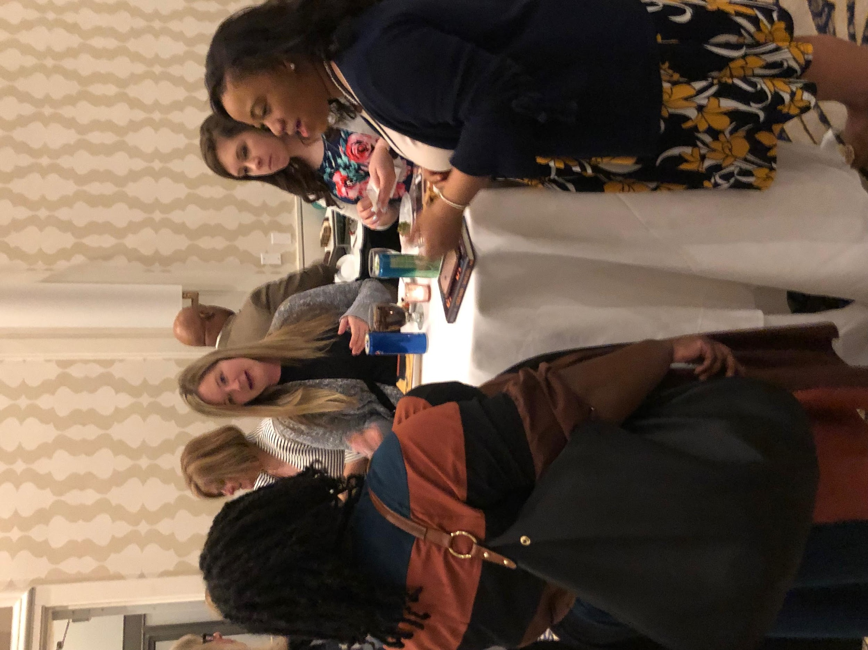
Decadent Desserts Social
An evening of sweet treats that is free for all conference attendees
*This event will take place immediately after our Evening With the Authors
Sponsored by Zaner-Bloser

Slide 43
April 3, 2020

Slide 44
Storytellers Breakfast
Chris Barton &
Jennifer Ziegler

Slide 45
Sharon Thomas
Senior Consultant at ICG, is a National Board Certified English teacher, instructional coach, student advocate, and writer. Along with her work in ICG workshops, Sharon coordinates the ICG Coaching Certification process. She is also a consultant for the Touchstones Discussion Project and a Certified SIM Professional Developer in the area of writing.

Slide 46
Bryan Collier

Slide 47
Steve Tutunick
Steve Tutunick knows how to inspire students to write.
First he gets them interested.

Slide 48
Keynote Speaker
Duane Abel
“Happy Teachers”

Slide 49
Torrey Maldonado
Notes:
Middle/HighTorrey Maldonado, the author of the critically acclaimed Secret Saturdays, is a teacher in Brooklyn, New York, where he was born, raised, and lives. His books reflect his students' and his experiences.

Slide 50
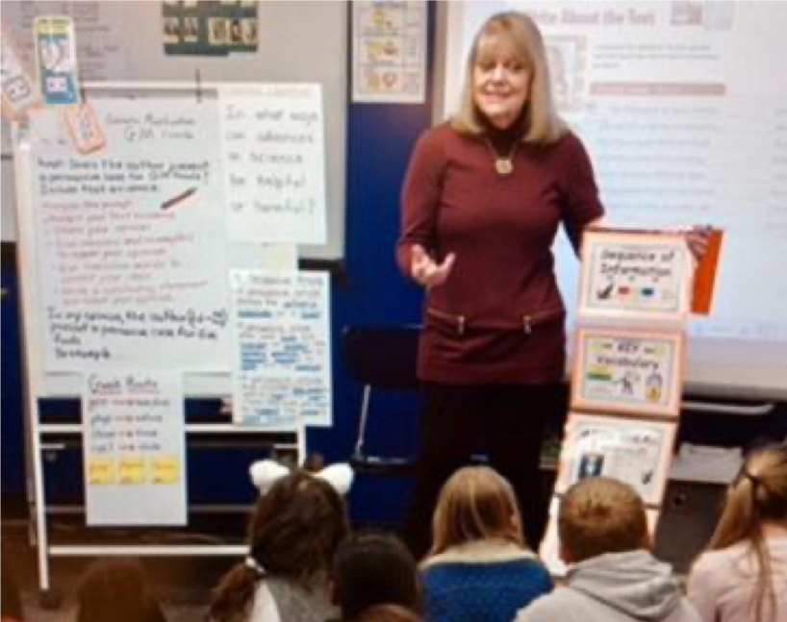
Kathy Bumgardner
Kathy Bumgardner is a veteran educator, with more than 30+ years as a classroom teacher, literacy coach, instructional specialist, and educational author
Notes:
kathy bumgardner

Slide 51
Chris Barton
Notes:
-primary; Austin TX based author

Slide 52
Alice Faye Duncan
Notes:
Primary- MEMPHIS, MARTIN AND THE MOUNTAINTOP
A 2019 Coretta Scott King Honor Medal
Also voted a "Best Picture Book in 2018' by Kirkus, SLJ and Booklist

Slide 53
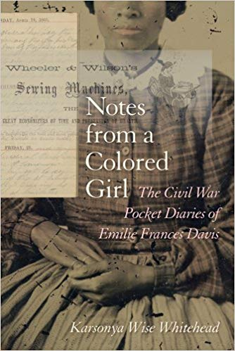
Dr. Kaye
Karsonya (Kaye) Wise Whitehead, award-winning author, professor, featured Public Commentator, K-12 master teacher in African American History; an award-winning curriculum writer and lesson plan developer; an award-winning former Baltimore City middle school teacher; and, a three-time New York Emmy-nominated documentary filmmaker.
Notes:
From 2013-2015, Dr. Whitehead was selected as one of only four experts to participate in the White House's Black History Month Panel co-sponsored by President Obama and the Association for the Study of African American Life and History (ASALH) on topics ranging from the Emancipation Proclamation to the president’s policies on women and girls. In 2014, she was one of the featured speakers at the Youth Mentoring Summit at the U.S. Capital in celebration of the 50th Anniversary of the March on Washington. She has received various fellowships and grants to support her work including a 2012 Gilder Lehrman Fellowship in American History, a 2011 Lord Baltimore Fellowship from the Maryland Historical Society, a 2010 NEH Summer Stipend, and a 2007 SREB Pre-Doctoral Fellowship for Maryland (only one doctoral fellowship is awarded per state).
In February 2016, Dr. Whitehead received the Joan B. Kroc’s Institute for International Peace Studies “Distinguished Alumni” Award for her work as a peace activist, scholar, filmmaker, writer, and poet. In 2016, her book, RaceBrave: new and selected works, was selected by the Baltimore Sun as one of the Top Ten Summer Reads. In 2015 her book, Notes from a Colored Girl, was awarded the Darlene Clark Hine Book Award for Best Book in African American women’s and gender history from the Organization of American Historians (OAH) and in 2014, it received the Letitia Woods Brown Book Award for Best Edited Book in African American History from the Association of Black Women Historians. In addition, Dr. Whitehead was awarded the 2014 Lifetime Achievement Award from the Progressive National Baptist Convention (PNBC); was selected as one of the top 25 women professors in Maryland by Online Schools Maryland; and in 2013, she was the recipient of Loyola University Maryland's Faculty Award for Excellence in Engaged Scholarship for her work documenting the stories of women who are temporarily experiencing homelessness. Whitehead has also received the 2006 Gilder Lehrman Preserve America Maryland History Teacher of the Year Award (sponsored by the Gilder Lehrman Institute of American History and the Maryland State Department of Education); was one of fifty alumni to receive the Distinguished Black Alumni Award from the University of Notre Dame, Indiana (2005); and, was a winner of both the Langston Hughes, David Diop, Etheridge Knight Poetry Award (1999, 2000) and the Zora Neale Hurston Creative Writing Award (1998) from the Gwendolyn Brooks Creative Writing Center at the University of Chicago.
Dr. Whitehead has trained over 3000 K-12 teachers throughout the country in how to become culturally responsive teachers in diverse environments. She is the author of several book chapters, articles, opinion editorials, and four books, RaceBrave: new and selected works (2016); Letters to My Black Sons: Raising Boys in a Post-Racial America (2015); the award-winning Notes from a Colored Girl: The Civil War Pocket Diaries of Emilie Frances Davis (2014); Sparking the Genius: The Carter G. Woodson Lecture (2014); and, the co-editor of Rethinking Emilie Frances Davis: Lesson Plans for Teaching her 1863-1865 Pocket Diaries (2014). Her forthcoming book, The Emancipation Proclamation: Race Relations on the Eve of Reconstruction (Routledge) is due out in 2017. She is the creator of the #SayHerName syllabus, the Clinton Syllabus, and the Trump Syllabus K12 Syllabus. She is also the guest editor for the fall 2016 special “#BlackGirlActivism” edition of Meridians journal.
Prior to her work in academia, Dr. Whitehead was a documentary filmmaker with MetroTV, a PBS-affiliate and a senior producer for Music Television Networks (MTV). In 2001, she directed and produced Twin Towers: A History, a documentary film that describes the technical problems that were overcome, including the challenge to the ironworkers and it recounts the daredevil stunts that the buildings attracted. The film was nominated for a New York-Emmy in 2002 (Dr. Whitehead’s third nomination). It has since become the second-largest selling film about 9/11 and airs regularly on PBS stations around the country.She received her Ph.D. from the University of Maryland, Baltimore County in the Language, Literacy, and Culture program, her M.A. from the University of Notre Dame, Indiana in International Peace Studies, her graduate degree in Advanced Documentary and Narrative Filmmaking from the New York Film Academy, and her B.A. from Lincoln University, PA.
Dr. Whitehead can be reached by email kewhitehead@loyola.edu, via twitter @kayewhitehead, or at her website www.kayewisewhitehead.com. She lives in Baltimore with her family.

Slide 54
Sydney Chaffee
"Education can transform students’ self-perceptions and arm them to fight for a more just the world.”

